Slide 1
Windows Tech Series Windows 10 Enterprise E3 in CSP Deployment
Speaker 1
Title
Speaker 2
Title

Slide 2
Agenda
Day | Day 1 Deployment | Day 2 Management | Day 3 Security | Day 4 Windows for CSP
 |  |  |  | Deployment | Management | Security
Synopsis | Module 1 – Introduction | Module 1 – Base System Setup | Module 1 – Analysis Of Common Threats | Module 1 – Subscription
 | Module 2 – Applications & Updates | Module 2 – Configuration | Module 2 – Hardening Windows | Module 2 – Deployment
 | Module 3 – Windows as a Service (WaaS) | Module 3 – Managing Client Devices | Module 3 – Advanced Threat Protection | Module 3 – Management
 | Module 4 – Browsers & Internet Security | Module 4 – Advanced management options I | Module 4 – Information Security (WIP/AIP) | Module 4 – Security
 | Module 5 – Secure Boot & Device Guard | Module 5 - Advanced management options II | Module 5 – Internet Security

Slide 3
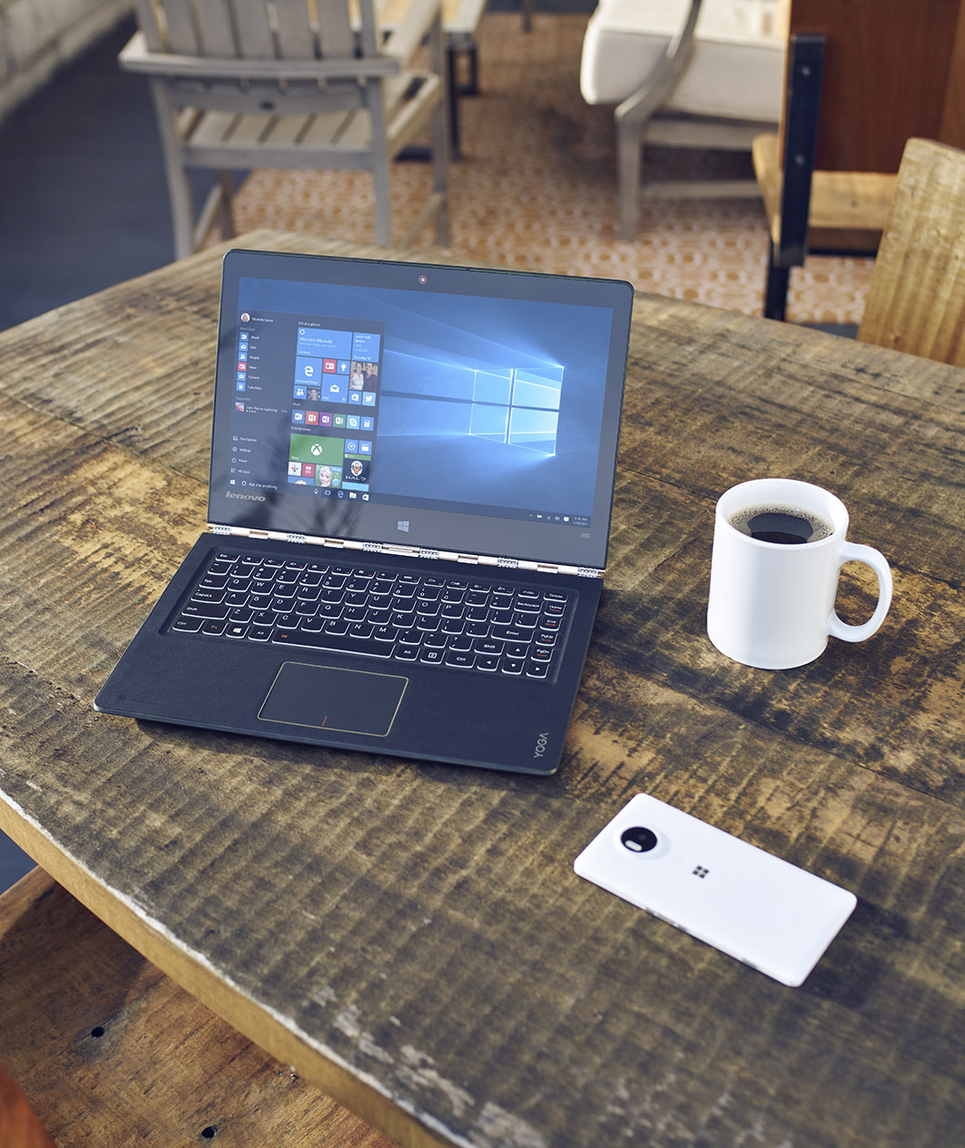
 | A better way for small and medium organizations to access the latest security, control and management features in Windows 10 Enterprise edition via a per-user subscription
 | Seamless step-up from Windows 10 Pro Anniversary Update with Azure AD sign-in
 | Simplified per-user licensing model, aligned with Office 365 and Azure
 | Designed for partner managed IT solutions delivered through CSP
Notes:
Key takeaway:
Windows 10 Enterprise E3 in the Cloud Solution Provider (CSP) program provides a better way for small and medium sized organizations to access the features in Windows 10 Enterprise.
Talking points:
Provides an automatic, seamless step-up from Windows 10 Pro Anniversary Update (version 1607) when a licensed user signs in by using their Azure AD credentials.
Uses a simplified, per-user licensing model that is aligned with Office 365 and Azure licensing models.
Allows partner IT managed solutions delivered through the CSP program.
Transition sentence:
Let’s take a deeper look at the Windows 10 Enterprise in CSP program.

Slide 4

Windows 10 Enterprise Edition Current Branch (CB) or Current Branch for Business (CBB)
$7 per user, per month
1 seat minimum, no seat limit
Alignment with Office 365 plans
5 device installs per user
Rollback to Pro functionality when subscription lapses (90 day grace)
Notes:
Key takeaway:
Windows 10 Enterprise E3 in the Cloud Solution Provider (CSP) program provides a better way for small and medium sized organizations to access the features in Windows 10 Enterprise.
Talking points:
Windows 10 Pro Anniversary Update (version 1607) contains all the Windows 10 Enterprise software components (.exe, .dll, and other binary files), but these features are dormant on a Windows 10 Pro device.
Provides organizations access to Windows 10 Enterprise edition for both Current Branch and Current Branch for Business (no Long Term Servicing Branch).
Can start with as few as one user, with no limit on the number of users that can be supported within an organization.
Ability to turn on Windows 10 Enterprise edition features on or off on a month-to-month basis, which aligns with the Office 365 plans.
User can install Windows 10 Enterprise on up to five devices.
If the subscription lapses (after the 90 day grace period), the data and ID security features in Windows 10 Enterprise are not turned off, but rather are put into a fixed state where the features continue to work, but cannot be changed until the subscription is renewed.
Transition sentence:
Let’s take a deeper look at the Windows 10 Enterprise in CSP program.

Slide 5

Why E3 in CSP?
Now all businesses, regardless of size, can realize the full Windows security vision
The most secure edition of Windows
Managed by a trusted partner
For the small business price of $7 per user, per month
Notes:
Key takeaway:
Windows 10 Enterprise E3 gives you the most secure edition of Windows 10, with a flexible, affordable subscription, that is managed by your trusted partner.
Talking points:
Windows 10 Enterprise edition is the most secure edition of Windows 10, that helps secure identities, data, and device access.
Windows 10 Enterprise E3 is managed by IT experts, so customers don’t incur any management overhead or complexity. This lets the customer focus on their business and is great for organizations that have no IT staff.
As already discussed, the program is designed to be affordable and flexible for small and medium sized organizations. Because it is a license, the cost becomes an operating expense instead of a capital expenditure. The pay-as-you-go subscription based licensing uses cloud-based provisioning.
If you fall into any of these categories, Windows 10 Enterprise edition can benefit your organization in the following ways:
Increased security: Helps make sure sensitive data, identities, and devices are protected from cybersecurity threats, give employees the freedom and flexibility to access sensitive data on a variety of devices, and help ensure employees see highly-sensitive data only on a need-to-know basis
Simplified licensing: Lowers your up-front costs, eliminate the need for time-consuming device counting and audits, and make it easier to stay compliant with a subscription-based, per-user licensing model.
Partner-managed IT: Offloads the task of configuring and managing devices to a partner experienced in Windows and cloud deployments. Your partner will also help you develop a device security and management strategy that uses the unique features of Windows 10 Enterprise Subscription to meet the specific needs of your business. This makes Windows Enterprise Subscription ideal for small and medium organizations who have limited or no in-house IT. You’ll also be able to view subscriptions and usage for Windows Enterprise, as well as any other Microsoft cloud services you may have purchased, in your partner portal.
Transition sentence:
Now let’s take a deeper look at the types of customers and their users that can benefit from Windows 10 Enterprise.
If you fall into any of these categories, Windows 10 Enterprise edition benefits your business in 3 key ways:
Increased security: help make sure sensitive data, identities, and devices are protected from cybersecurity threats, give employees the freedom and flexibility to access sensitive data on a variety of devices, and help ensure employees see highly-sensitive data only on a need-to-know basis
Simplified licensing: lower your up-front costs, eliminate the need for time-consuming device counting and audits, and make it easier to stay compliant with a subscription-based, per-user licensing model.
Partner-managed IT: offload the task of configuring and managing devices to a partner experienced in Windows and cloud deployments. Your partner will also help you develop a device security and management strategy that uses the unique features of Windows 10 Enterprise Subscription to meet the specific needs of your business. This makes Windows Enterprise Subscription ideal for SMBs who have limited or no in-house IT. You’ll also be able to view subscriptions and usage for Windows Enterprise, as well as any other Microsoft cloud services you may have purchased, in your partner portal.

Slide 6
Windows 10 Enterprise features not found in Pro
Help prevent Pass the Hash attacks – one of the key tactics used in security breaches – with Credential Guard*, which offers additional protection for users authenticated on your network against malware running in the operating system.
Get best-in-class security and control. Safeguard your data, devices, and get greater levels of control and flexibility. We can work with you to determine how to implement these solutions in the way that best suits your business
Get extra protection to keep your devices safe from malware, untrusted apps, and executables with Device Guard*.
Help prevent the execution of unwanted and unknown applications within your network by locking down which apps and sites you want – and don’t want – to run on devices, using AppLocker management, which works with your existing infrastructure.
Simplify application management using App-V. Because applications are not installed directly on end user devices, there are no conflicts or compatibility issues to worry about and your apps stay current and protected with the latest security updates and functionality.
Optimize security by customizing and locking down the user experience on specific devices – such as kiosks – so they can only perform certain functions with Managed User Experience.
* Credential Guard and Device Guard may require specific hardware
Notes:
Key takeaway:
Windows 10 Enterprise E3 gives you the most secure edition of Windows 10, with a flexible, affordable subscription, that is managed by your trusted partner.
Talking points:
Credential Guard. This feature uses virtualization-based security to protect security secrets (e.g., NTLM password hashes, Kerberos Ticket Granting Tickets) so that only privileged system software can access them. This helps prevent Pass-the-Hash or Pass-the-Ticket attacks.
Credential Guard has the following features:
Hardware-level security. Credential Guard uses hardware platform security features (such as Secure Boot and virtualization) to help protect derived domain credentials and other secrets.
Virtualization-based security. Windows services that access derived domain credentials and other secrets run in a virtualized, protected environment that is isolated.
Improved protection against persistent threats. Credential Guard works with other technologies (e.g., Device Guard) to help proved further protection against attacks, no matter how persistent.
Improved manageability. Credential Guard can be managed through Group Policy, Windows Management Instrumentation (WMI), or Windows PowerShell.
For more information, see Protect derived domain credentials with Credential Guard.
Device Guard. This feature is a combination of hardware and software security features that allows only trusted applications to run on a device. This means that even if an attacker manages to get control of the Windows kernel, he or she will be much less likely to run executable code after the computer restarts. Device Guard uses virtualization-based security in Windows 10 Enterprise to isolate the Code Integrity service from the Windows kernel itself, which lets the service use signatures defined by customer-defined policies to help determine which code is trustworthy.
Device Guard does the following:
Helps eliminate malware
Helps protect the Windows system core from vulnerability and zero-day exploits
Runs only those apps trusted by the customer
For more information, see Device Guard overview.
AppLocker. This feature helps IT pros determine which applications and files users can run on a device (also known as “whitelisting”). The applications and files that can be managed include executable files, scripts, Windows Installer files, dynamic-link libraries (DLLs), packaged apps, and packaged app installers. For more information, see AppLocker.
Microsoft Application Virtualization (App-V). This feature makes applications available to end users without installing the applications directly on users’ devices. App-V transforms applications into centrally managed services that are never installed and don't conflict with other applications. This feature also helps ensure that applications are kept current with the latest security updates. For more information, see Application Virtualization.
Managed User Experience. This feature helps customize and lock down the user interface of a Windows device to restrict the device to performing a specific task, such as acting as a check-in kiosk at an airport. For example, you can:
Protect a device from write operations: using Unified Write Filter (UWF), you can intercept all write attempts to a protected volume and redirect them to a virtual overlay instead. You can also specify any files, directories, and registry keys that should not be filtered.
Control the start screen layout and access to USB devices
Automatically boot to a Classic Windows app: using Shell Launcher in Windows 10, you can launch Classic Windows apps as a custom shell to create a dedicated device and app experience. You also gain flexibility and control by using multiple shells for different user groups.
Automatically boot to a Universal Windows app: using the Assigned Access setting, you can restrict a specific standard account to using only one Windows Store app. For example, you can restrict customers at your business to using only one app so your PC acts like a kiosk.
Transition sentence:
Now let’s take a deeper look at the types of customers and their users that can benefit from Windows 10 Enterprise.

Slide 7

Customer targets
~30% of SMBs in Developed Markets
Access, process or store highly-sensitive customer data
Regulated industries, including publicly listed companies
In-house software or IP development
Notes:
Key takeaway:
Windows 10 Enterprise E3 gives you the most secure edition of Windows 10, with a flexible, affordable subscription, that is managed by your trusted partner.
Talking points:
The following users are just some of the users that can benefit from Windows 10 Enterprise edition:
Users that access, process, or store highly-sensitive data.
Users that work in regulated industries, including publicly listed companies.
Users that develop in house software or are a part of IP development.
The following are some examples of small and medium-size business categories that could benefit from the Windows 10 Enterprise edition :
Healthcare:
Physician’s practice
Physical therapy clinic
Biotech startup
Retail:
Local drugstore chain
Financial/Professional Services:
Investment advisory firm
Legal firm
Insurance agency
Manufacturing:
Small food manufacturing company
Transition sentence:
Now let’s take a look at what preparations need to be made at the customer prior to deploying Windows 10 Enterprise in their environment.

Slide 8
Customer preparation
Notes:
Key takeaway:
There are some preparation tasks that need to be performed prior to deploying Windows 10 Enterprise E3 licenses at a customer.
Talking points:
In this section, we will identify some preparation tasks that need to be performed prior to deploying Windows 10 Enterprise E3 licenses.
Transition sentence:
First, lets let’s take a look at how to provision the user accounts in Office 365/Azure AD.

Slide 9
Provision accounts in Office 365/Azure AD
AD DS on-premises
AD DS in cloud
No AD DS
Create Office 365 tenant
Create Office 365 tenant
Create Office 365 tenant
Install Azure AD Connect
Install Azure AD Connect
Provision accounts directly in Office 365/Azure AD
Synchronize accounts
Synchronize accounts
Provides users with single identity that provides them access to on-premises apps and cloud-based services.
Notes:
Key takeaway:
Ultimately, the customer’s user and group accounts need to be provisioned in Office 365/Azure Ad.
Talking points:
Customers can fall into one of the following account provisioning scenarios:
Has on-premises AD DS. These customers need to provision an Office 365 tenant (if not already provisioned). Install the Azure AD Connect (free tool from Microsoft) on-premises or in Azure. And finally synchronize their AD DS user and group accounts with Azure AD.
Has cloud-based AD DS. These customers need to provision an Office 365 tenant (if not already provisioned). Install the Azure AD Connect (free tool from Microsoft) in Azure. And finally synchronize their AD DS user and group accounts with Azure AD.
Has no AD DS. These customers need to provision an Office 365 tenant (if not already provisioned). Because they do not have an AD DS, you can provision the user and group account directly in Office 365/Azure AD. You can manually add each account in the Office 365 Admin portal or bulk import the user accounts from a .csv file.
The ultimate goal is to provide users with a single identity that provides them access on-premises apps and cloud-based services.
Transition sentence:
Let’s see how to upgrade existing user devices, running a version of Windows other Than Windows 10 Pro Anniversary Update (version 1607), to Windows 10 Pro Anniversary Update.

Slide 10
Upgrade user devices to Windows 10 Pro
Currently running
Upgrade to
Upgrade to
Windows XP Home
Windows 10 Pro
Anniversary Update
Full Packaged Product
Or
Volume License
Windows Vista Home
Windows 10 Home
Full Packaged Product
Windows 7 Home
Windows 8.1 Home
Windows 10 Home
Windows XP Pro
Windows Vista Pro
Windows 7 Pro
Windows 8.1 Pro
Notes:
Key takeaway:
All devices must be running Windows 10 Pro Anniversary Update (version 1607) before the device can be upgraded to Windows 10 Enterprise.
Talking points:
If a device is running Windows XP Home, Windows Vista Home, Windows 7 Home, or Windows 8.1 Home, the device must first upgraded to Windows 10 Home (fully packaged product). Then the device needs to be upgraded to Windows 10 Pro Anniversary Update (version 1607), full packaged product or volume license.
If a device is running Windows 10 Home, the device can be directly upgraded to Windows 10 Pro Anniversary Update (version 1607), full packaged product or volume license.
If a device is running a version of Windows XP Pro, Windows Vista Pro, Windows 7 Pro, or Windows 8.1 Pro, the device can be directly upgraded to Windows 10 Pro Anniversary Update (version 1607), full packaged product or volume license.
Transition sentence:
Let’s see how to manage the customer subscription in the Partner Center.

Slide 11
Manage customer subscription
Notes:
Key takeaway:
You manage the customer subscription in the Partner Center.
Talking points:
In this section, we will see how to manage the customer subscription in the Partner Center.
Transition sentence:
First, lets let’s take a look at how to sign-in to the Partner Center.

Slide 12
Entering the Partner Center
Notes:
Key takeaway:
First, you need to sign in to the Partner Center.
Talking points:
In the next few slides we will see how to sign-in to the Partner Center.
Transition sentence:
First, lets let’s take a look at how to sign-in to the Partner Center.

Slide 13
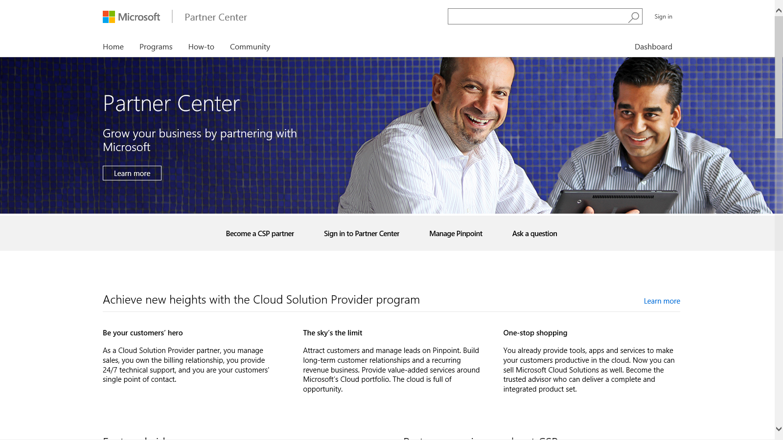
Go to the Partner Center homepage
Go to https://partnercenter.microsoft.com to go to the Partner Center homepage. Click on Dashboard or Sign in to Partner Center.
Notes:
Key takeaway:
It is easy to sign in to the Partner Center from the Partner Center home page.
Talking points:
On the Partner Center home page, click on Sign in to Partner Center.
Transition sentence:
Next, you enter or CSP tenant credentials.

Slide 14
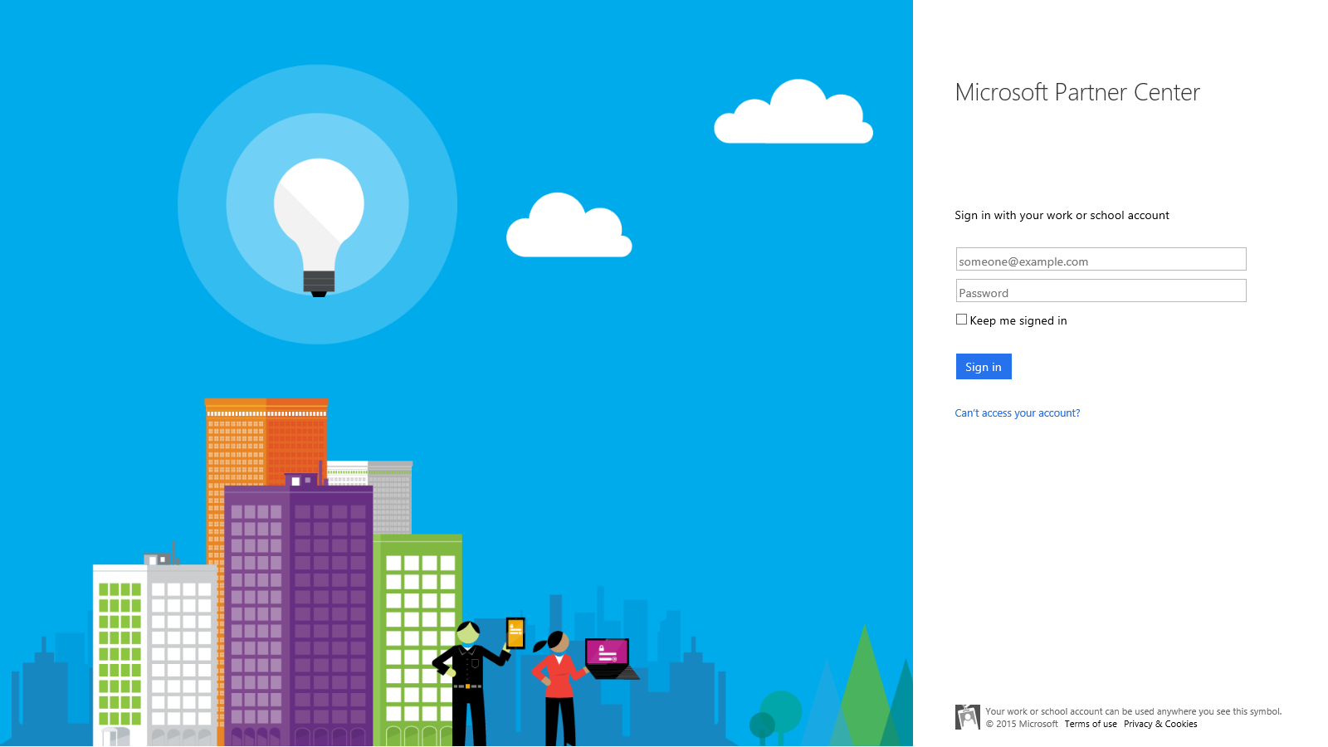
Sign in to the Partner Center using your CSP tenant credentials (same credentials used with the Partner Admin Center)
Use the AAD Join credentials associated with the tenant you used to onboard to CSP.
Notes:
Key takeaway:
You can sign in to the Partner Center by using your CSP tenant credentials.
Talking points:
On the Sign in with your work or school account page, sign in with your CSP tenant credentials.
Transition sentence:
Next, you select the Windows 10 Enterprise E3 offer.

Slide 15
Selecting an offer for a new customer
Notes:
Key takeaway:
Next, you need select the Windows 10 Enterprise E3 offer for a customer as you create the customer.
Talking points:
In the next few slides we will see how to select the Windows 10 Enterprise E3 offer for a customer in the Partner Center.
Transition sentence:
First, lets let’s take a look at how to add the Windows 10 Enterprise E3 licenses as you create a new customer.

Slide 16
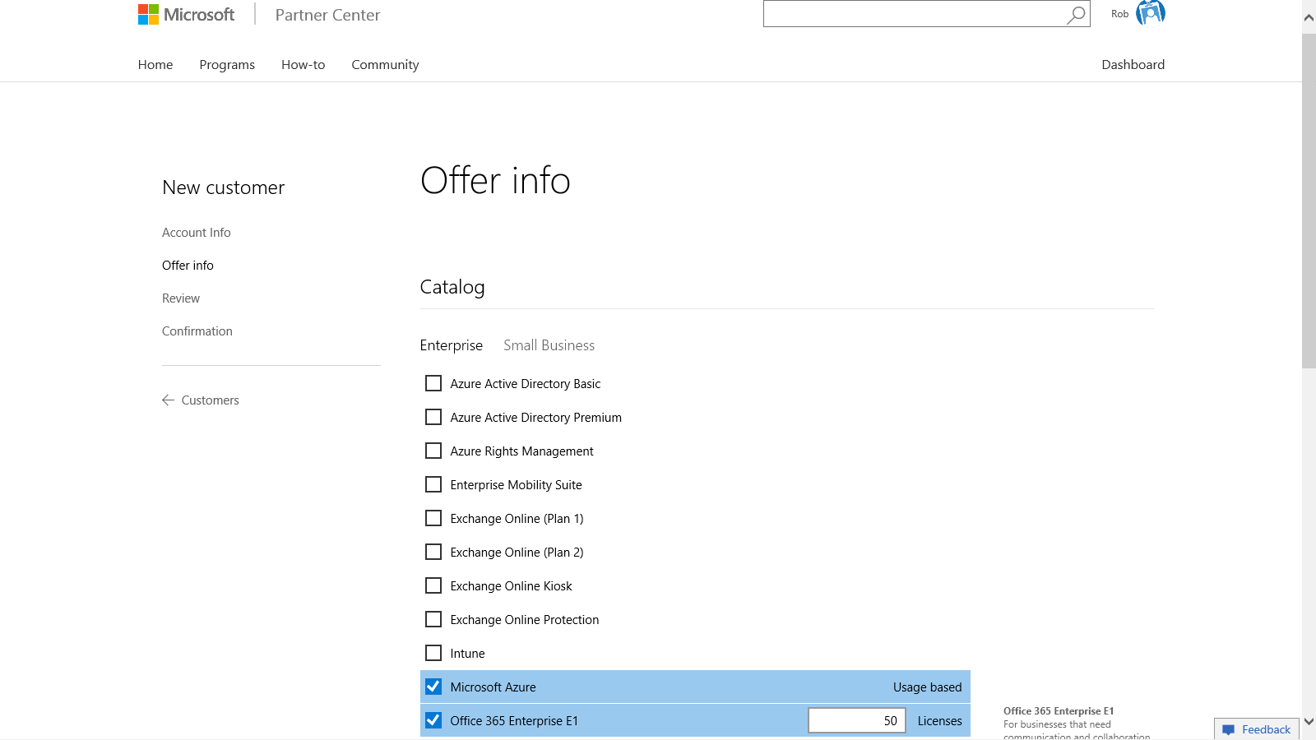
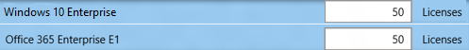
Select the offers and desired number of seats. Click Next: Review
Select one or more offers, along with the number of licenses for each offer. In this example, Windows Enterprise offer and Office 365 E1 are selected. Click Next: Review
Notes:
Key takeaway:
You can add the Windows 10 Enterprise offer as you create a customer.
Talking points:
You can add the Windows 10 Enterprise offer (including the number of licenses) as you create a customer in the Partner Center.
Transition sentence:
Next, let’s see the newly created customer in the Partner Center.

Slide 17
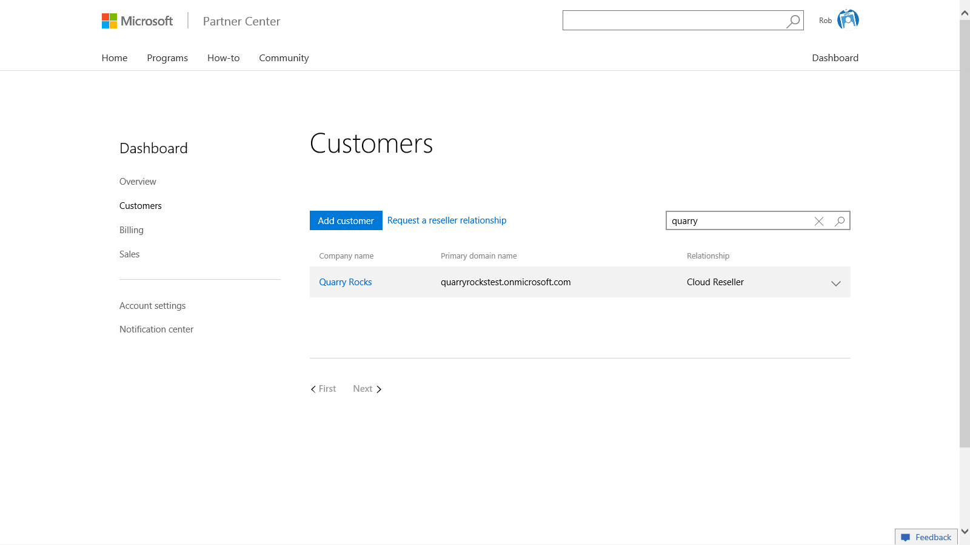
The new customer now appears on the Customers list
The new customer will appear on the Customers list. Note: it may take up to a couple of minutes for the customer to appear on the list.
Notes:
Key takeaway:
You can view the newly created customer in the Partner Center.
Talking points:
You can view the newly created customer in the list of your customers in the Partner Center. It can take a few minutes for the newly created customer to appear in the list of customers.
Transition sentence:
Next, let’s see how you can assign additional subscription licenses to an existing customer.

Slide 18
Add subscriptions to existing customer
Notes:
Key takeaway:
You can also add Windows 10 Enterprise E3 subscription licenses to existing customers.
Talking points:
In the next few slides we will see how to add Windows 10 Enterprise E3 subscription licenses to existing customers in the Partner Center.
Transition sentence:
First, lets let’s take a look at how to add the Windows 10 Enterprise E3 licenses as you create a new customer.

Slide 19
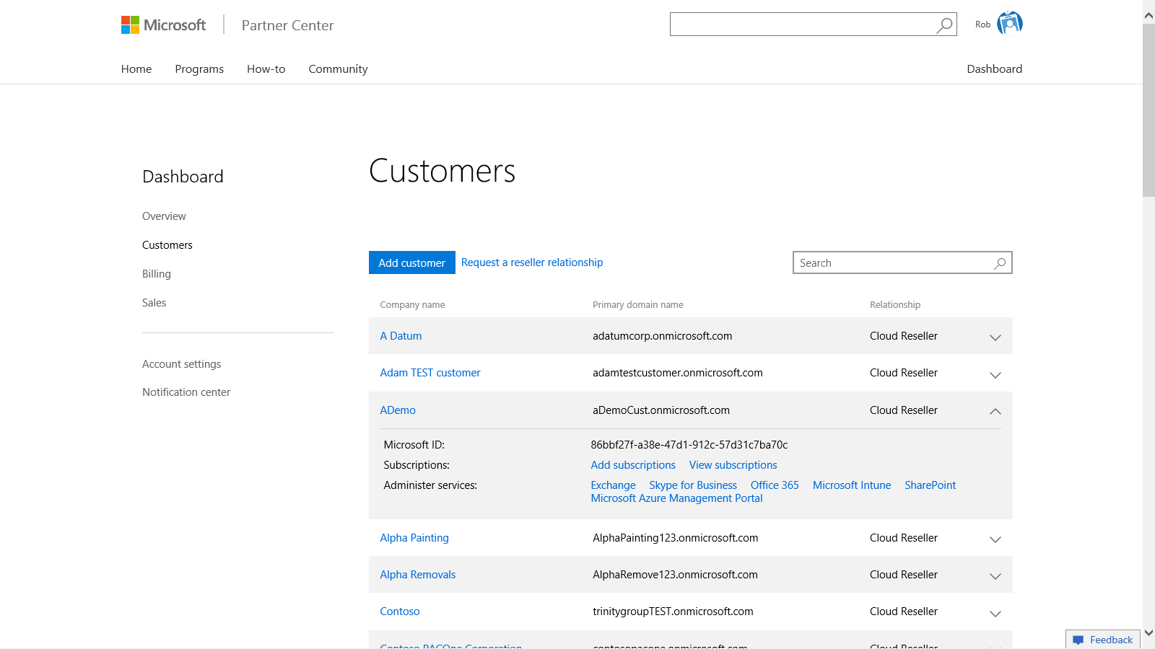
From the Customers page, click Add subscriptions
To provision new subscriptions for a customer, first click on the down arrow in the far right column to show the expanded details for the customer. Then click Add subscriptions.
Notes:
Key takeaway:
You can add Windows 10 Enterprise E3 subscription licenses to an existing customer.
Talking points:
You can add Windows 10 Enterprise E3 subscription licenses to an existing customer by expanding the customer information and then clicking the Add subscriptions hyperlink .
Transition sentence:
Next, let’s see how you to assign additional Windows 10 E3 subscription licenses to the customer.

Slide 20
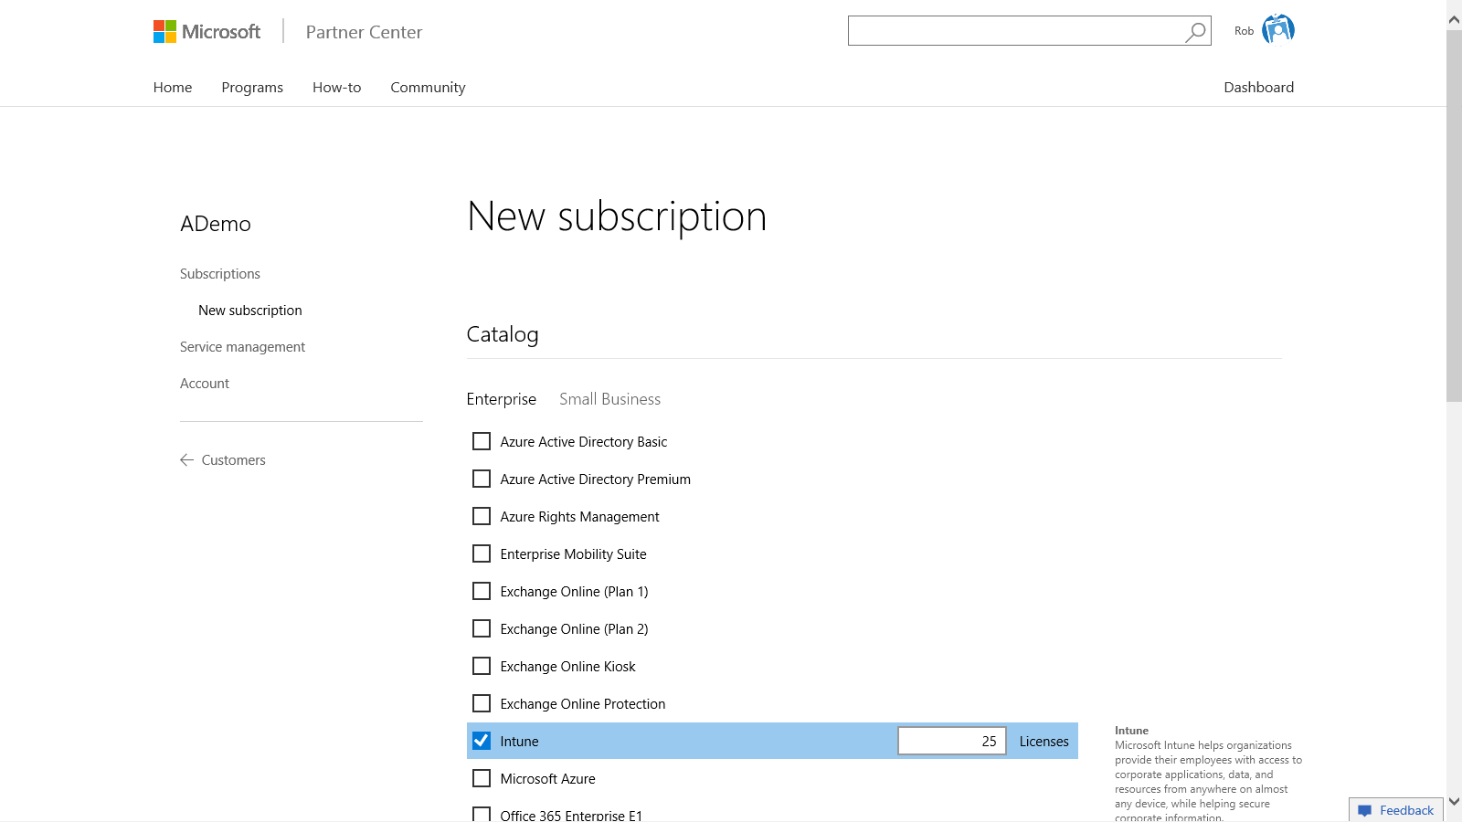
Select the offer(s) and number of licenses. Click submit
Select the offer(s) and number of licenses for each new subscription. Click Submit.
Notes:
Key takeaway:
You can add the desired number of Windows 10 Enterprise E3 subscription licenses to an existing customer.
Talking points:
You can add Windows 10 Enterprise E3 subscription licenses to an existing customer by selecting the Windows 10 Enterprise checkbox and then entering the number of licenses.
Transition sentence:
Finally, let’s look at the newly added licenses in the customer subscription information.

Slide 21
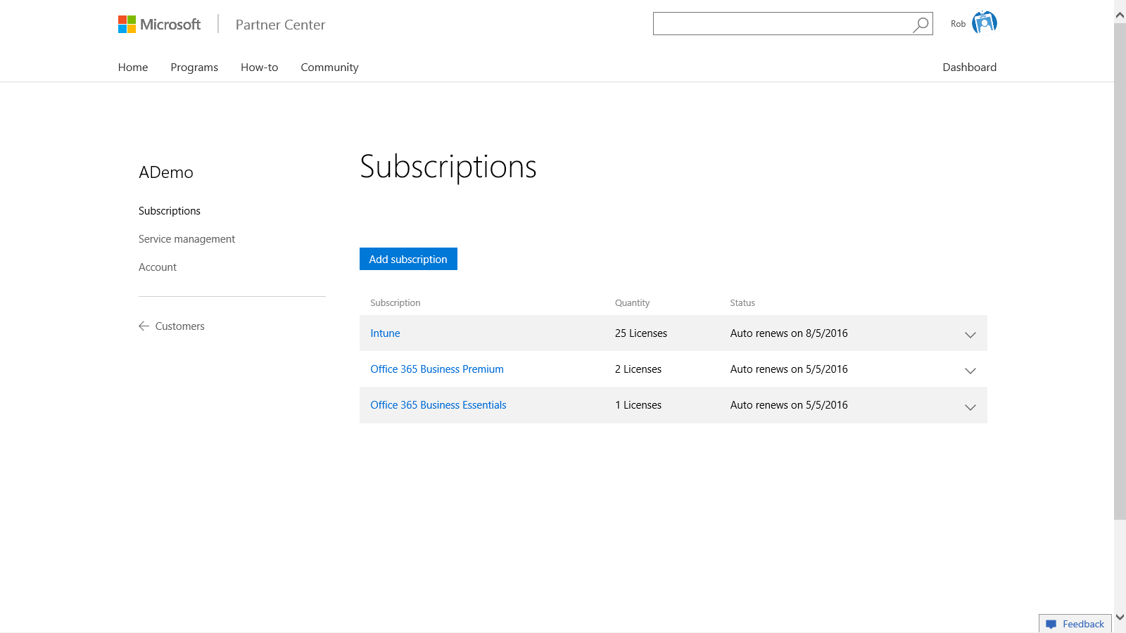
New subscription now appears on the Subscriptions list for the customer.
New subscriptions now appear on the customer’s Subscriptions page. You can see the number of licenses in the Quantity column and the date in which the subscription auto-renews in the Status column.
Notes:
Key takeaway:
You can see the newly added Windows 10 Enterprise licenses in the list of customer subscriptions.
Talking points:
You can see the newly added Windows 10 Enterprise E3 subscription licenses in the Subscriptions panel for a customer.
Transition sentence:
In the next section, we’ll see how to view current invoice, past invoices, and reconciliation files in the Billing panel.

Slide 22
Partner billing
Notes:
Key takeaway:
You can view your billing information in the Partner Center.
Talking points:
In the next few slides we will see view current invoice, past invoices, and reconciliation files in the Billing panel in the Partner Center.
Transition sentence:
Let’s take a look at the Billing panel in the Partner Center

Slide 23
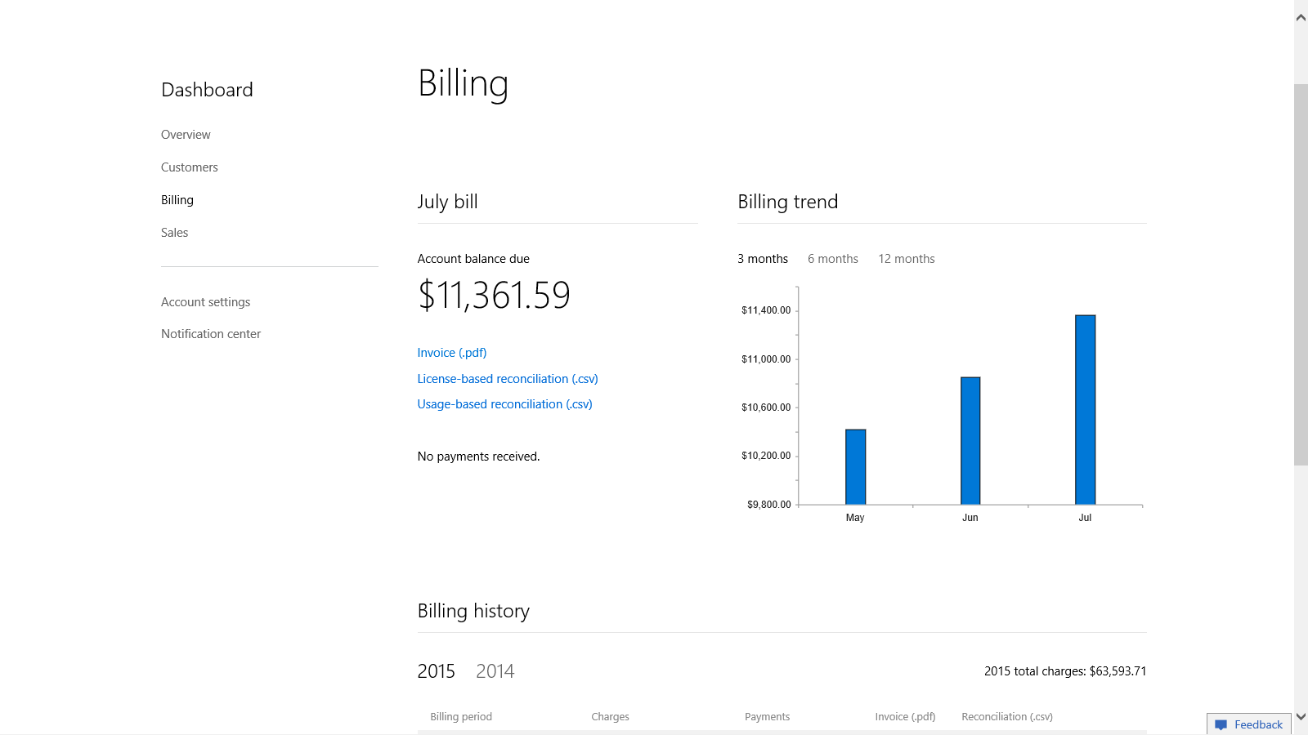
View your current and past invoice details:
Microsoft billing partner UI – billing is monthly with an annual minimum partner commitment
From the Partner Center Dashboard, click Billing to view your current invoice, past invoices and reconciliation files.
Notes:
Key takeaway:
You can see your Microsoft billing information in the Billing panel in the Partner Center.
Talking points:
You can see the Microsoft billing information (such as current invoice, past invoices, and reconciliation files ) in the Billing panel in the Partner Center.
Transition sentence:
In the next section, we’ll see the user experience for signing in to a Windows 10 Pro Anniversary Update (version 1607) device and automatically upgrading to Windows 10 Enterprise.

Slide 24
Explore the upgrade experience
Notes:
Key takeaway:
The end-user experience is totally transparent to the user, all they have to do is sign-in by using their Azure AD credentials.
Talking points:
The end-user experience is transparent.
Users sign-in by using their Azure AD credentials.
Windows 10 automatically applies the Windows 10 Enterprise E3 license and enables the Windows 10 Enterprise features.
Transition sentence:
Now let’s look at what your users will experience when we assign a Windows 10 Enterprise E3 license to them.

Slide 25
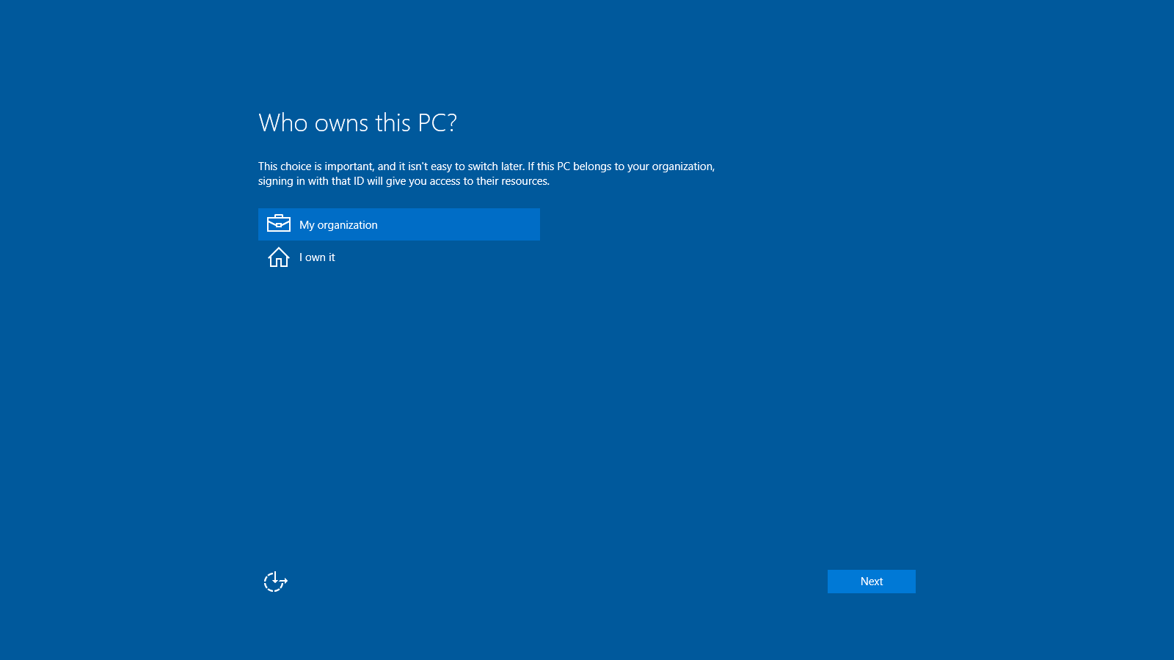
Users who have a new device will sign-in using their Azure AD credentials by selecting their organization as the device owner
Notes:
Key takeaway:
First, let’s look at the process for a user who has a new device running Windows 10 Pro.
Talking points:
New device is running Windows 10 Pro.
User experience for a new device or first time a device is setup.
User selects the My organization option on this page.
Transition sentence:
Let’s continue the Windows 10 Pro setup process.

Slide 26
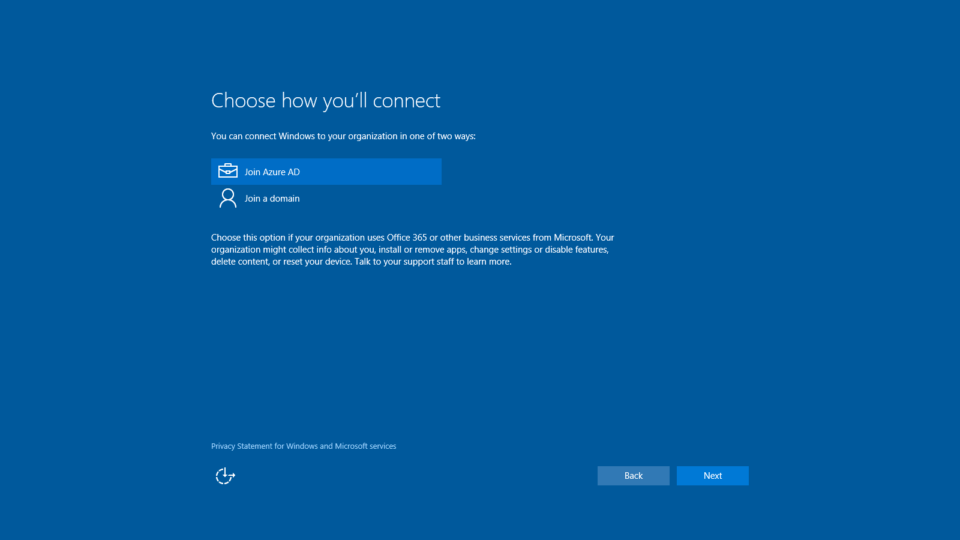
Users who have a new device will select to join Azure AD
Notes:
Key takeaway:
The user needs to join Azure AD during the initial Windows 10 Pro setup.
Talking points:
Joining Azure AD during initial Windows 10 Pro setup allows the user to sign-in by using their Azure AD credentials.
Azure AD join is required for Windows 10 Enterprise E3 subscription.
Transition sentence:
Next the user signs-in by using their Azure AD credentials.

Slide 27
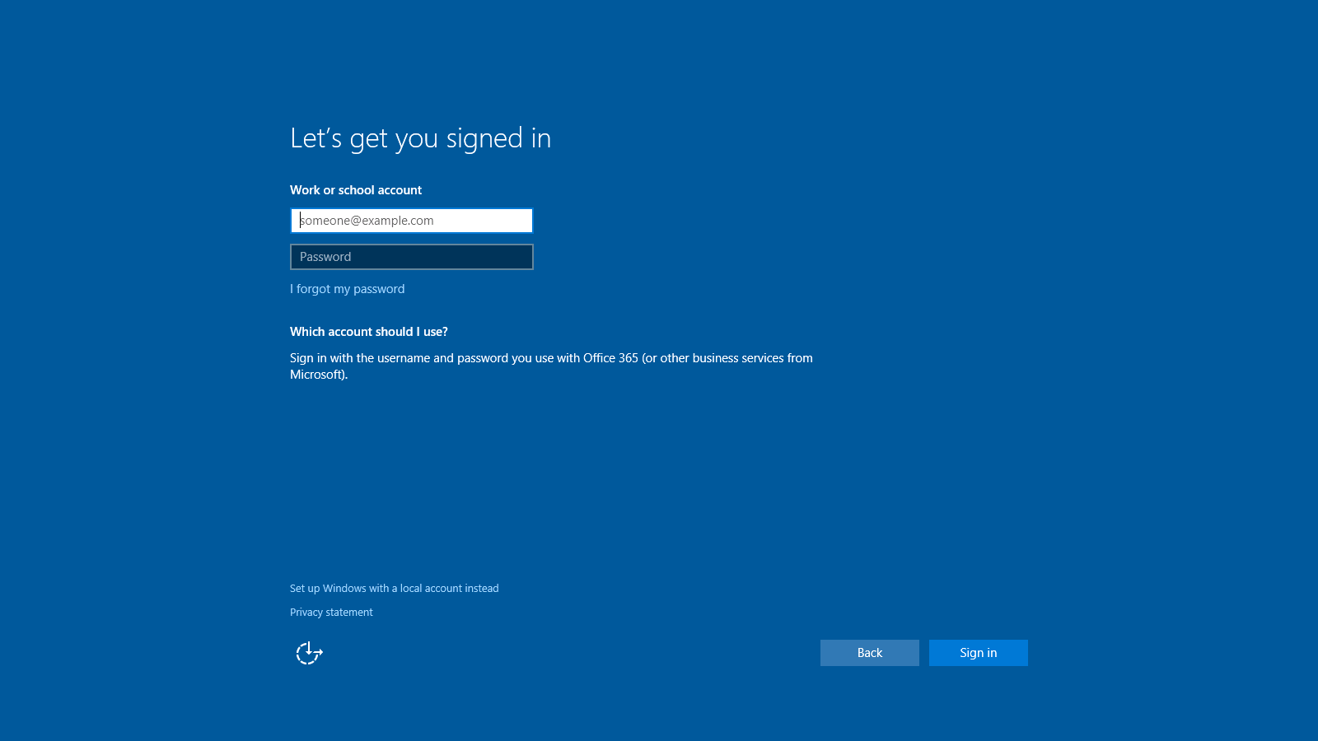
Users sign-in by using their Azure AD credentials
Notes:
Key takeaway:
The user signs-in to Azure AD by using their Azure AD credentials during the initial Windows 10 Pro setup.
Talking points:
The user to signs-in to Azure AD by using their Azure AD credentials (email account) during the initial Windows 10 Pro setup.
Windows 10 Pro uses the domain portion of the user’s email account to determine which Azure AD tenant to sign-in and join.
Transition sentence:
Next the user signs-in to Windows 10 after initial Windows 10 Pro setup.

Slide 28
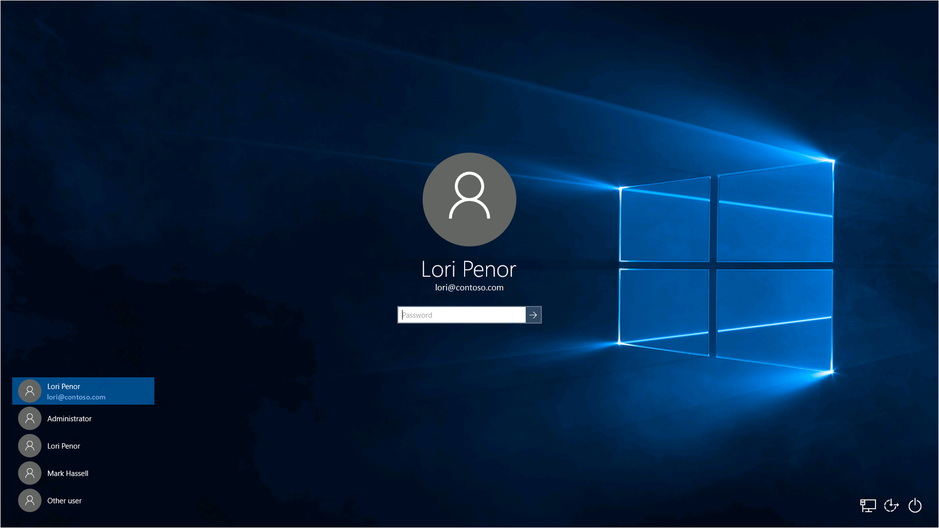
Users sign-in to Windows 10 by using their Azure AD credentials
Notes:
Key takeaway:
The user signs-in to Windows 10 by using their Azure AD credentials.
Talking points:
The user to signs-in to Windows 10 by using their Azure AD credentials (email account).
Windows 10 authenticates the user by using Azure AD.
Transition sentence:
Next the user checks the edition and subscription information.

Slide 29
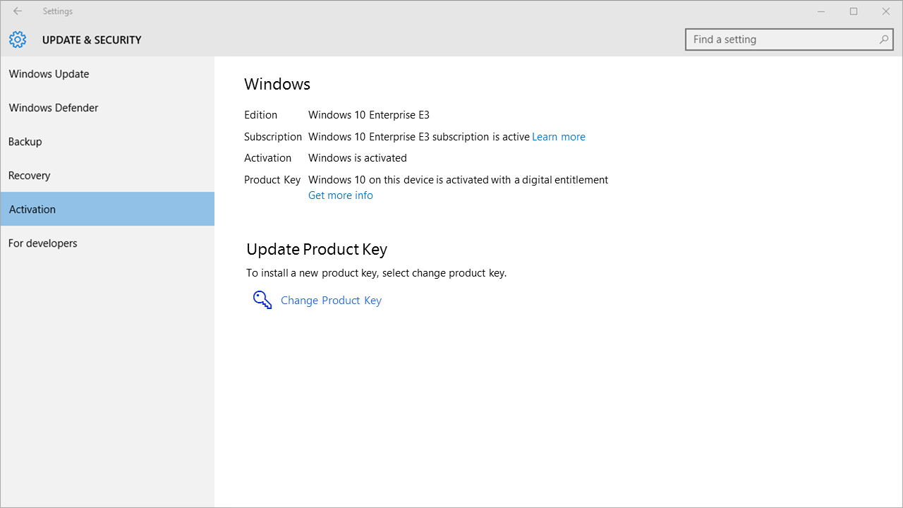
When the user signs-in, Windows 10 Pro is automatically updated to Windows 10 Enterprise
Notes:
Key takeaway:
When the user signs-in, Windows 10 Pro is automatically updated to Windows 10 Enterprise.
Talking points:
User goes to Settings > Update & Security > Activation to view edition and subscription information
Windows 10 automatically obtains the Windows 10 Enterprise E3 license.
Windows 10 automatically activates the subscription.
Windows 10 automatically enables Windows 10 Enterprise features on the device.
Transition sentence:
Next let’s see what happens when the Windows 10 Enterprise E3 license expires.

Slide 30
Troubleshoot user experience
Notes:
Key takeaway:
Most of the time no problems are experienced in the user experience, but this section covers those few times when something does go wrong.
Talking points:
This section covers some of the common issues that users can experience when upgrading from Windows 10 Pro Anniversary Update (version 1607) to Windows 10 Enterprise.
Transition sentence:
Now let’s look at what your users will experience when we assign a Windows 10 Enterprise E3 license to them.

Slide 31

Common issues
Windows 10 Pro is not activated
Windows 10 Enterprise E3 subscription is invalid
Notes:
Key takeaway:
The common issues relate to Windows 10 Pro not being active and/or Windows 10 Enterprise E3 subscription being invalid.
Talking points:
Existing Windows 10 Pro Anniversary Update (version 1607) is not activated. This is typically caused by the device not being properly licensed and activated prior to assigning the Windows 10 Enterprise E3 license to the user and the user signing in.
Windows 10 Enterprise E3 subscription license is invalid. This is typically caused by the license expiring or being transferred to another user (after 90 day grace period).
Transition sentence:
Over the next few slides, we will show you how to determine which combination of these issues a user may be experiencing.

Slide 32
Windows 10 Pro is activated.
Windows 10 Enterprise E3 subscription is valid.
Notes:
Key takeaway:
This shows the Activation panel when Windows 10 Pro is activated and the Windows 10 Enterprise E3 subscription is valid.
Talking points:
User goes to Settings > Update & Security > Activation to view edition and subscription information
Windows 10 automatically obtains the Windows 10 Enterprise E3 license.
Windows 10 automatically activates the subscription.
Windows 10 automatically enables Windows 10 Enterprise features on the device.
Transition sentence:
Next let’s see what happens when the Windows 10 Pro is not activated, but the Windows 10 Enterprise E3 subscription is valid

Slide 33
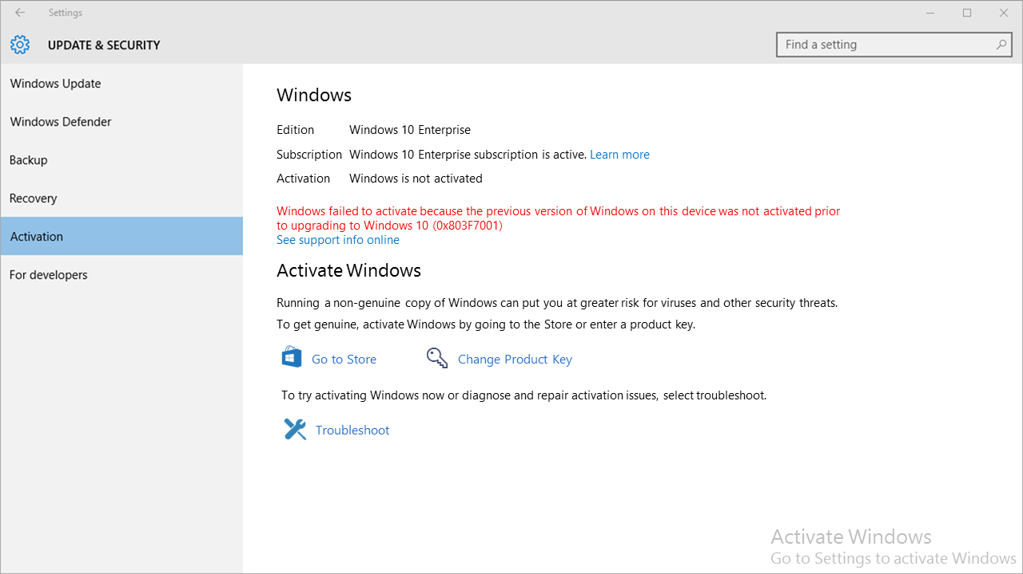
Windows 10 Pro is not activated.
Windows 10 Enterprise E3 subscription is valid.
Notes:
Key takeaway:
This shows the Activation panel when Windows 10 Pro is not activated and the Windows 10 Enterprise E3 subscription is valid.
Talking points:
User goes to Settings > Update & Security > Activation to view edition and subscription information
Windows 10 automatically obtains the Windows 10 Enterprise E3 license.
Windows 10 automatically activates the subscription.
Windows 10 automatically enables Windows 10 Enterprise features on the device.
Transition sentence:
Next let’s see what happens when the Windows 10 Pro is activated, but the Windows 10 Enterprise E3 subscription is invalid

Slide 34
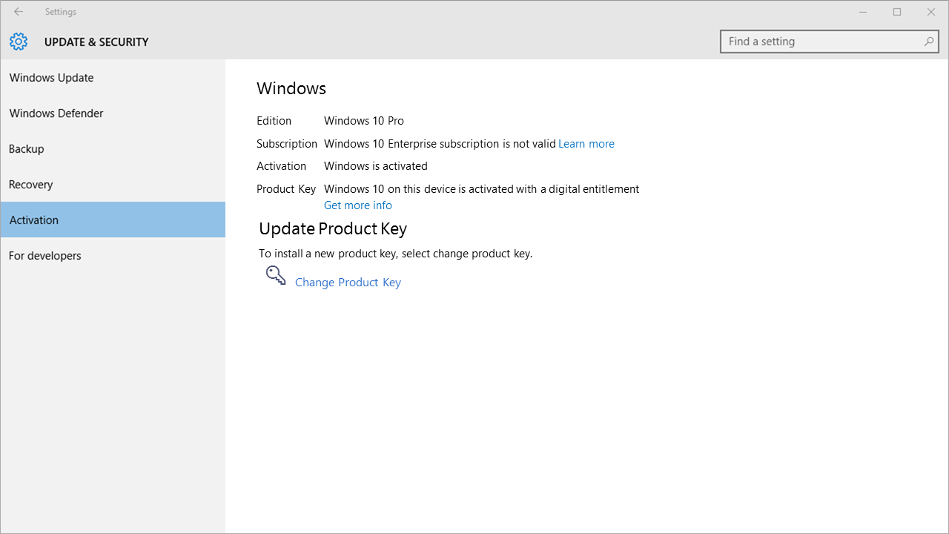
Windows 10 Pro is activated.
Windows 10 Enterprise E3 subscription is invalid.
Notes:
Key takeaway:
This shows the Activation panel when Windows 10 Pro is activated and the Windows 10 Enterprise E3 subscription is invalid.
Talking points:
User goes to Settings > Update & Security > Activation to view edition and subscription information
Windows 10 automatically obtains the Windows 10 Enterprise E3 license.
Windows 10 automatically activates the subscription.
Windows 10 automatically enables Windows 10 Enterprise features on the device.
Transition sentence:
Next let’s see what happens when the Windows 10 Pro is not activated, but the Windows 10 Enterprise E3 subscription is invalid.

Slide 35
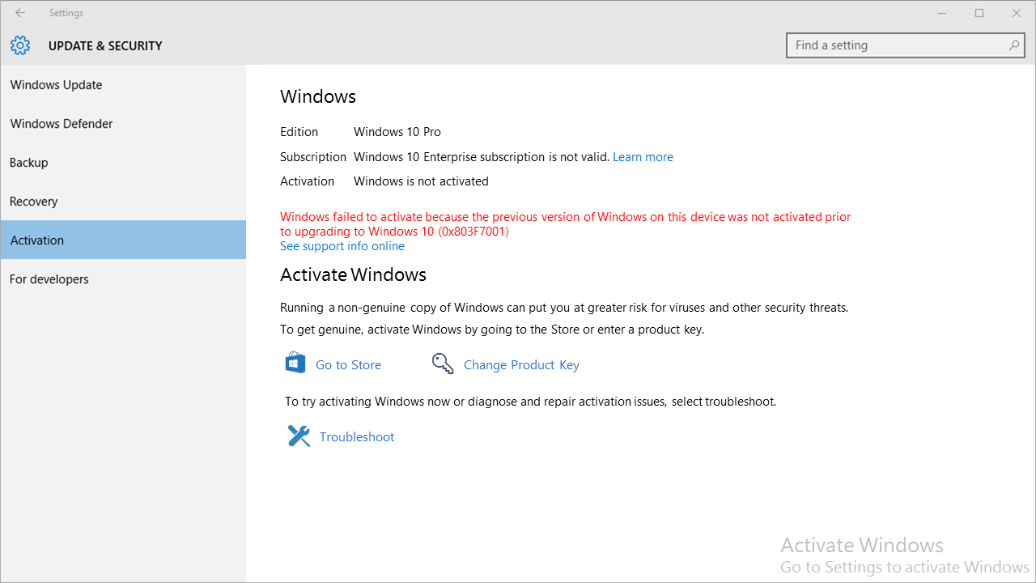
Windows 10 Pro is not activated.
Windows 10 Enterprise E3 subscription is invalid.
Notes:
Key takeaway:
This shows the Activation panel when Windows 10 Pro is not activated and the Windows 10 Enterprise E3 subscription is invalid.
Talking points:
User goes to Settings > Update & Security > Activation to view edition and subscription information
Windows 10 automatically obtains the Windows 10 Enterprise E3 license.
Windows 10 automatically activates the subscription.
Windows 10 automatically enables Windows 10 Enterprise features on the device.
Transition sentence:
In the next section, let’s take a look at how to deploy the Windows 10 Enterprise features so that the user can realize the benefit.

Slide 36
Deploy Windows 10 Enterprise features
Notes:
Key takeaway:
Now that Windows 10 Enterprise is running on the desired user devices, you need to help the customer take advantage of the new features.
Talking points:
This section provides an overview of how to configure the customer’s environment to take advantage of the Windows 10 Enterprise improved security and management features.
Transition sentence:
First, let’s take a look at how to configure the customer’s environment for Credential Guard.

Slide 37
Credential Guard
Credential Guard uses Windows 10 virtualization-based security features (Hyper-V features) that must be enabled on each device before you can turn on Credential Guard.
Automated
Manual
You can automatically turn on Credential Guard for one or more devices by using Group Policy. The Group Policy settings automatically add the virtualization-based security features and configure the Credential Guard registry settings on managed devices.
You can manually turn on Credential Guard by doing the following:
Add the virtualization-based security features by using Programs and Features or Deployment Image Servicing and Management (DISM).
Configure Credential Guard registry settings by using the Registry Editor or the Device Guard and Credential Guard hardware readiness tool.
Notes:
Key takeaway:
The easiest method to configure the customer’s environment for Credential Guard is by using Group Policy.
Talking points:
You can implement Credential Guard on Windows 10 Enterprise devices by turning on Credential Guard on these devices. Credential Guard uses Windows 10 virtualization-based security features (Hyper-V features) that must be enabled on each device before you can turn on Credential Guard. You can turn on Credential Guard by using one of the following methods:
Automated. You can automatically turn on Credential Guard for one or more devices by using Group Policy. The Group Policy settings automatically add the virtualization-based security features and configure the Credential Guard registry settings on managed devices.
Manual. You can manually turn on Credential Guard by doing the following:
Add the virtualization-based security features by using Programs and Features or Deployment Image Servicing and Management (DISM).
Configure Credential Guard registry settings by using the Registry Editor or the Device Guard and Credential Guard hardware readiness tool.
You can automate these manual steps by using a management tool such as System Center Configuration Manager.
For more information about implementing Credential Guard, see the following resources:
Protect derived domain credentials with Credential Guard
PC OEM requirements for Device Guard and Credential Guard
Device Guard and Credential Guard hardware readiness tool
Note Credential Guard requires UEFI 2.3.1 or greater with Trusted Boot; Virtualization Extensions such as Intel VT-x, AMD-V, and SLAT must be enabled; x64 version of Windows; IOMMU, such as Intel VT-d, AMD-Vi; BIOS Lockdown; TPM 2.0 recommended for device health attestation (will use software if TPM 2.0 not present)
Transition sentence:
Next, let’s take a look at how to configure the customer’s environment for Device Guard.

Slide 38
Device Guard
Optionally, create a signing certificate for code integrity policies.
Create code integrity policies from “golden” computers.
Audit the code integrity policy and capture information about applications that are outside the policy.
Capture needed policy information from the event log, and merge information into the policy as needed.
Create a “catalog file” for unsigned line-of-business (LOB) applications.
Deploy code integrity policies and catalog files.
Enable desired hardware security features.
Notes:
Key takeaway:
Configuring the customer’s environment for Device Guard is an iterative process that requires you to audit policies for a period of time before you enforce them.
Talking points:
Configure the customer’s environment to support Device Guard by performing the following steps:
Optionally, create a signing certificate for code integrity policies. As you deploy code integrity policies, you might need to sign catalog files or code integrity policies internally. To do this, you will either need a publicly issued code signing certificate (that you purchase) or an internal certificate authority (CA). If you choose to use an internal CA, you will need to create a code signing certificate.
Create code integrity policies from “golden” computers. When you have identified departments or roles that use distinctive or partly distinctive sets of hardware and software, you can set up “golden” computers containing that software and hardware. In this respect, creating and managing code integrity policies to align with the needs of roles or departments can be similar to managing corporate images. From each “golden” computer, you can create a code integrity policy and decide how to manage that policy. You can merge code integrity policies to create a broader policy or a master policy, or you can manage and deploy each policy individually.
Audit the code integrity policy and capture information about applications that are outside the policy. We recommend that you use “audit mode” to carefully test each code integrity policy before you enforce it. With audit mode, no application is blocked—the policy just logs an event whenever an application outside the policy is started. Later, you can expand the policy to allow these applications, as needed.
Create a “catalog file” for unsigned line-of-business (LOB) applications. Use the Package Inspector tool to create and sign a catalog file for your unsigned LOB applications. In later steps, you can merge the catalog file's signature into your code integrity policy so that applications in the catalog will be allowed by the policy.
Capture needed policy information from the event log, and merge information into the existing policy as needed. After a code integrity policy has been running for a time in audit mode, the event log will contain information about applications that are outside the policy. To expand the policy so that it allows for these applications, use Windows PowerShell commands to capture the needed policy information from the event log, and then merge that information into the existing policy. You can merge code integrity policies from other sources also, for flexibility in how you create your final code integrity policies.
Deploy code integrity policies and catalog files. After you confirm that you have completed all the preceding steps, you can begin deploying catalog files and taking code integrity policies out of audit mode. We strongly recommend that you begin this process with a test group of users. This provides a final quality-control validation before you deploy the catalog files and code integrity policies more broadly.
Enable desired hardware security features. Hardware-based security features—also called virtualization-based security (VBS) features—strengthen the protections offered by code integrity policies.
For more information about implementing Device Guard, see Device Guard deployment guide.
Transition sentence:
Next, let’s take a look at how to configure the customer’s environment for AppLocker management.

Slide 39
AppLocker management
Manage AppLocker by using Group Policy
Group Policy requires AD DS infrastructure
User devices must be AD DS domain joined and Azure AD joined
Create AppLocker rules in Group Policy Objects
Target AppLocker rules (in Group Policy Objects) to devices in organizational units
Notes:
Key takeaway:
The easiest method to configure the customer’s environment for AppLocker is by using Group Policy.
Talking points:
You can manage AppLocker in Windows 10 Enterprise by using Group Policy.
Group Policy requires that the customer have AD DS and that the Windows 10 Enterprise devices are joined to the customer’s AD DS domain.
You can create AppLocker rules by using Group Policy, and then target those rules to the appropriate devices.
For more information about AppLocker management by using Group Policy, see AppLocker Policies Deployment Guide.
Transition sentence:
Next, let’s take a look at how to configure the customer’s environment for App-V.

Slide 40
App-V
App-V server provides App-V management, virtualized app publishing, app streaming, and reporting services. Each of these services can be run on one server or can be run individually on multiple servers.
App-V requires that the customer have an App-V infrastructure, including these components:
App-V sequencer is a typical client device that is used to sequence (capture) apps and prepare them for streaming from the App-V server. You install apps on the App-V sequencer, and the App-V sequencer software determines the files and registry settings that are changed during app installation. Then the sequencer captures these settings to create a virtualized app.
App-V client is installed on any client device that wants to stream apps from the App-V server. These will be the Windows 10 Enterprise E3 devices.
System Center Configuration Manager is optional, but can be integrated with App-V to provide finer control and deployment of virtualized applications..
Notes:
Key takeaway:
App-V requires that the customer have an App-V infrastructure, including the App-V server, App-V sequencer, and App-V client.
Talking points:
Review the text in the slide.
For more information about implementing the App-V server, App-V sequencer, and App-V client, see the following resources:
How to Deploy the App-V 5.0 Server
How to Deploy the App-V Client
How to Install the Sequencer
Deploying App-V 5.0
Transition sentence:
Next, let’s take a look at how to configure the customer’s environment for the Managed User Experience features.

Slide 41
Managed User Experience
Start layout customization enables you to customize Start layouts for different departments or organizations, with minimal management overhead and no reimaging.
The Managed User Experience feature is a set of Windows 10 Enterprise edition features and corresponding settings that you can use to manage user experience.
Unbranded boot allows you to suppress Windows elements that appear when Windows starts or resumes and can suppress the crash screen when Windows encounters an error from which it cannot recover.
Custom logon lets you to suppress Windows 10 UI elements that relate to the Welcome screen and shutdown screen.
Shell launcher lets you enable Assigned Access to run only a classic Windows app via Shell Launcher so that the app replaces the shell.
Keyboard filter allows you to suppress undesirable key presses or key combinations (such as Ctrl+Alt+Tab).
Unified write filter helps protect your physical storage media, including most standard writable storage types that are supported by Windows, such as physical hard disks, solid-state drives, internal USB devices, external SATA devices, and so on.
Notes:
Key takeaway:
The Managed User Experience feature is a set of Windows 10 Enterprise edition features and corresponding settings that you can use to manage user experience.
Talking points:
Review the text in the slide.
For more information on each corresponding topic, see the following resources:
Customize Windows 10 Start and taskbar with Group Policy
Unbranded Boot
Custom Logon
Shell Launcher
Keyboard Filter
Unified Write Filter
Transition sentence:
Now let’s look at what your users will experience when we assign a Windows 10 Enterprise E3 license to them.

Slide 42
Conclusion
Notes:
Key takeaway:
Lets talk about what are the next actions to take and answer any of your questions.
Talking points:
Let’s talk about call to action items and answer questions.
Transition sentence:
So what are the next steps?

Slide 43

Call to action
Review technical documentation and other resources on the Microsoft Partner Network Portal
Attend a Windows 10 Tech Series event
Complete Windows 10 Enterprise sales training on Windows Drumbeat
Notes:
Key takeaway:
Try out the Windows 10 Enterprise E3 in Cloud Solution Provider program.
Talking points:
Review the technical documentation and other resources on the Microsoft Partner Network Portal.
Attend a Windows 10 Tech Series event. Contact your Microsoft Partner Sales Executive for further information regarding events scheduled in your area.
Complete Windows 10 Enterprise sales training on Windows Drumbeat.
Transition sentence:
Do you have any questions?

